Slide 1
TEAM 1
Contributors: Sriram Chunduri
Parimala Gutta
Divya Sree Kuntamalla
Srikar reddy nelavetla
Krunal Desai

Slide 2
Model Choice
Why did we choose Logistic Regression and XGBoost?
We selected Logistic Regression for its simplicity and interpretability. It's a linear model that provides transparency in decision-making.
XGBoost, on the other hand, was chosen for its remarkable ability to capture complex, non-linear patterns. It excels at boosting model performance.
What AUC score did XGBoost achieve?
XGBoost demonstrated a strong performance, achieving an impressive AUC score of 0.93, which indicates its effectiveness in distinguishing between classes.

Slide 3
How the Models Work
For Logistic Regression:
The logistic function and sigmoid curve map input features to probabilities.
A linear decision boundary is established to classify data points into two classes based on a weighted sum of input features.
For XGBoost:
XGBoost is an ensemble model that combines multiple decision trees.
It utilizes the concept of gradient boosting, where each subsequent tree corrects the errors of the previous ones, gradually improving predictive accuracy.

Slide 4
Combination of Different Models
Why did we combine Logistic Regression and XGBoost?
We combined these models to harness the strengths of both.
Logistic Regression provides a simple and transparent baseline, while XGBoost complements it by capturing intricate and non-linear patterns.
The combination leverages the interpretability of Logistic Regression and the predictive power of XGBoost.

Slide 5
XGBoost Worked Best
What factors contributed to XGBoost outperforming Logistic Regression?
XGBoost's success can be attributed to its ability to capture complex, non-linear relationships, which might be crucial for our dataset.
Additionally, it is robust in handling missing values and outliers, making it suitable for real-world datasets.
The specific characteristics of our dataset favor XGBoost, enabling it to achieve the high AUC score.

Slide 6
Hyperparameter Tuning
How did we optimize XGBoost's performance?
We engaged in hyperparameter tuning to fine-tune the XGBoost model.
Parameters like learning rate, max depth, and the number of estimators were carefully adjusted.
We employed techniques such as cross-validation to ensure the best parameter settings for optimal performance.

Slide 7
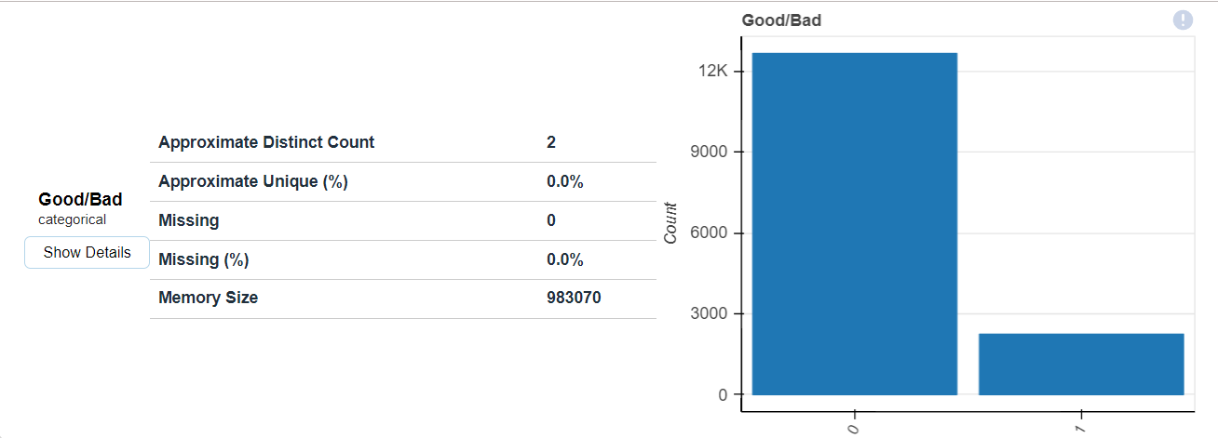
Data Visualization:

Slide 8
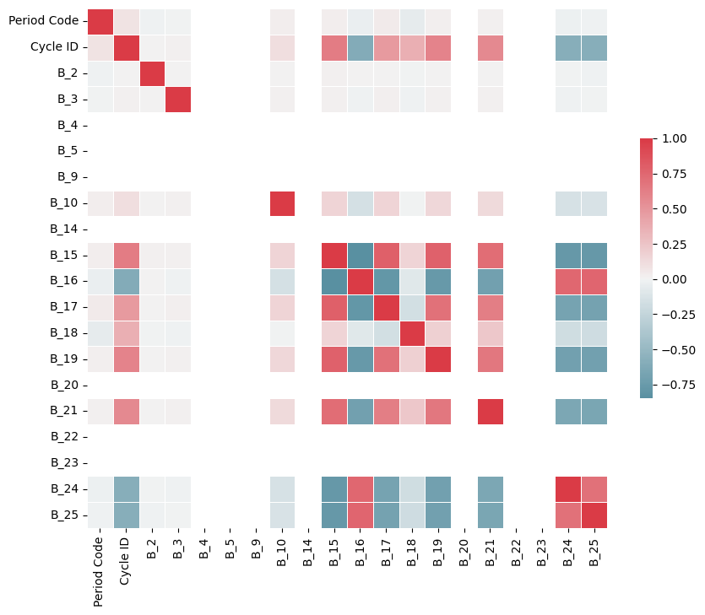

Slide 9
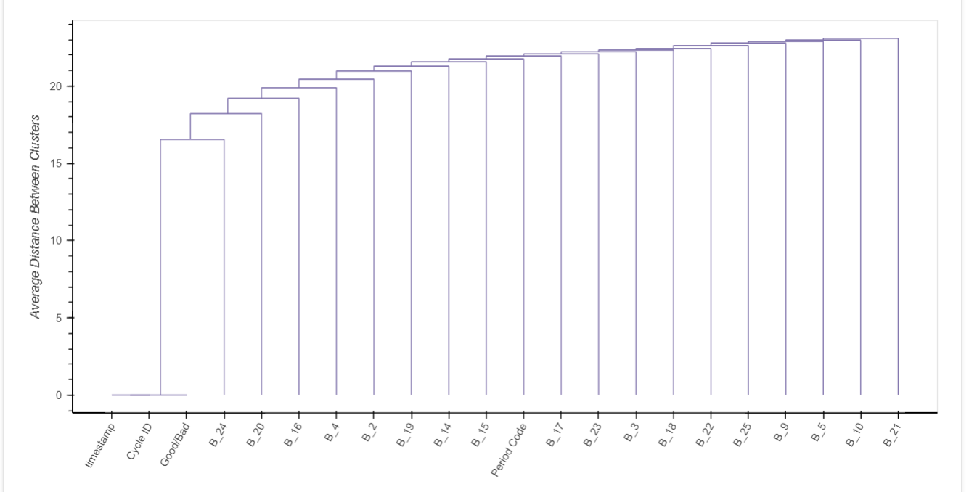

Slide 10
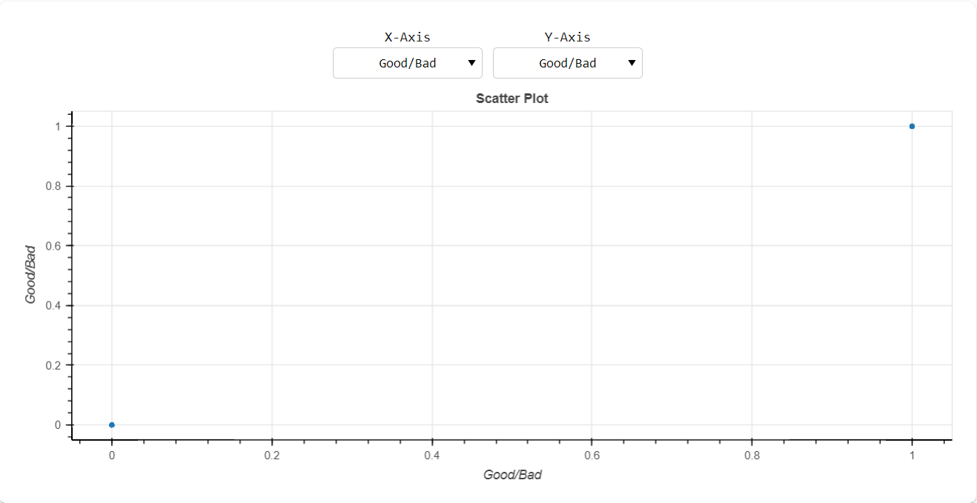

Slide 11
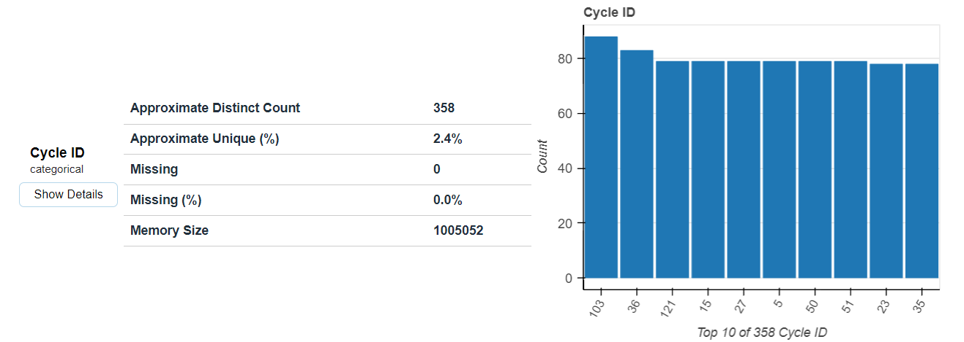

Slide 12
Accuracy Report
The ROC (Receiver Operating Characteristic) curve plots the True Positive Rate (sensitivity) against the False Positive Rate (1-specificity).
The AUC (Area Under the Curve) quantifies the overall model performance. A higher AUC signifies a more effective model at distinguishing between classes.
ROC: 0.935
Accuracy=0.946

Slide 13
Key takeaways from our presentation
We observed that XGBoost outperformed Logistic Regression with an AUC of 0.93.
This presentation highlighted the significance of thoughtful model selection, hyperparameter tuning, and metric choice in machine learning projects.
It underscores the importance of choosing the right tool for the specific dataset and problem.

